Slide 1
A.R.M - Aerial Refueling Manipulator
Pat Hoskins
Joe Perrella

Slide 2
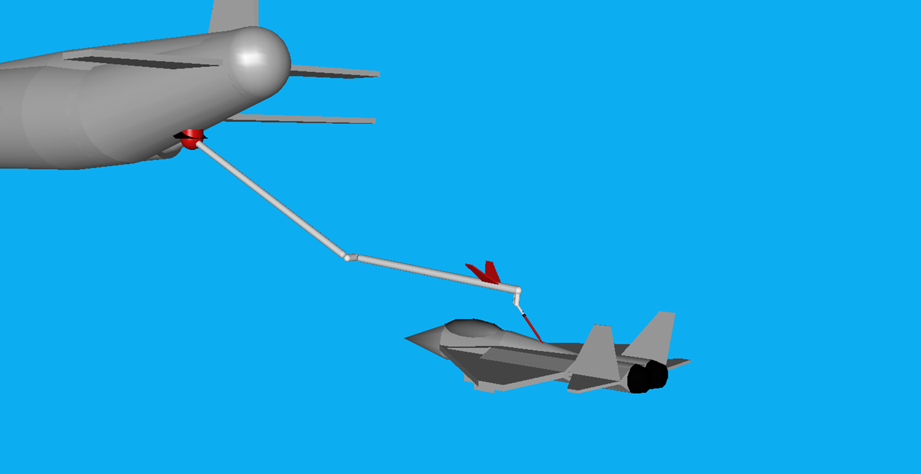
Aerial Refueling Manipulator

Slide 3
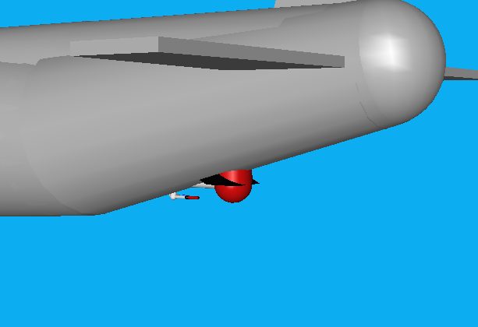
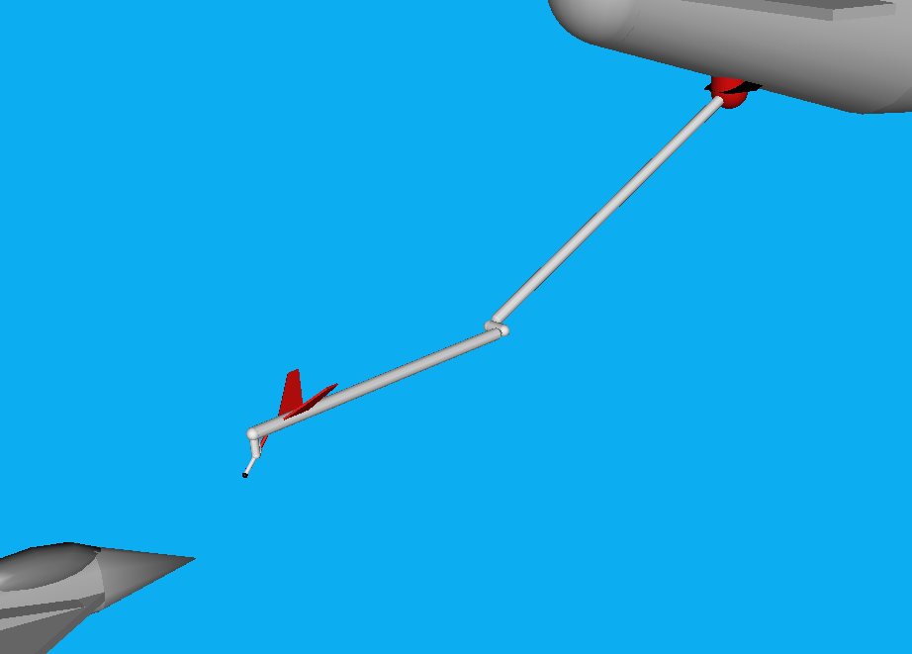
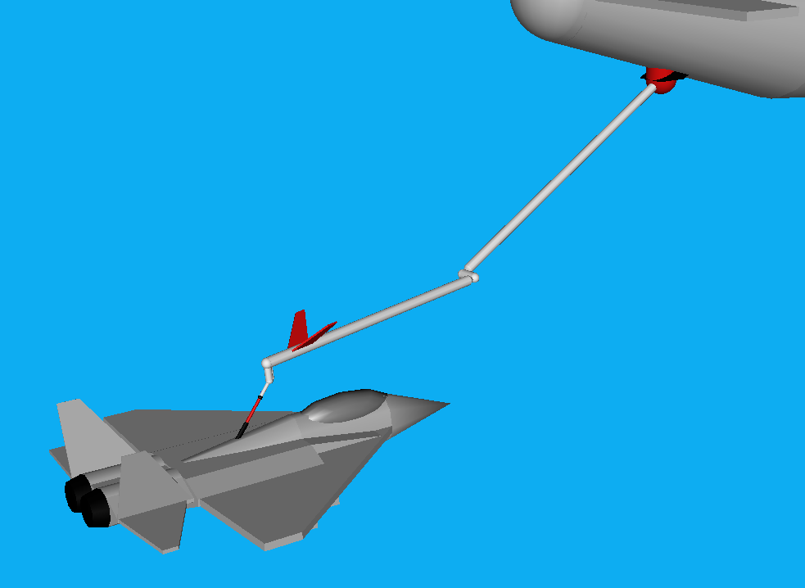
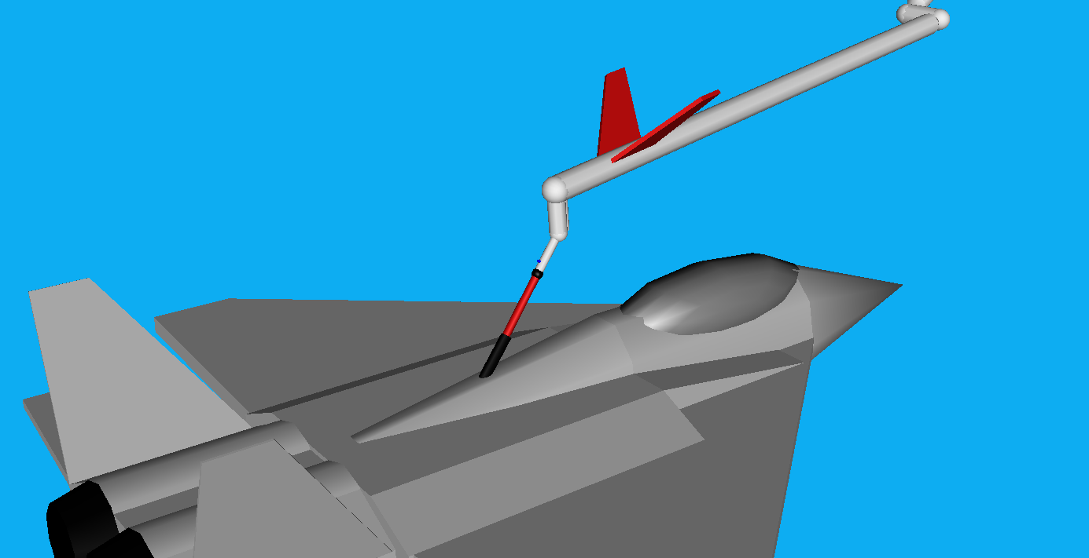

Robotic Task
Initial Configuration
Intermediate Configuration
Final Configuration
A.R.M’s nozzle will extend up to 4 feet to enter a tailing aircraft’s fuel port
A.R.M
F-16 Fuel Port
Retractable Nozzle

Slide 4
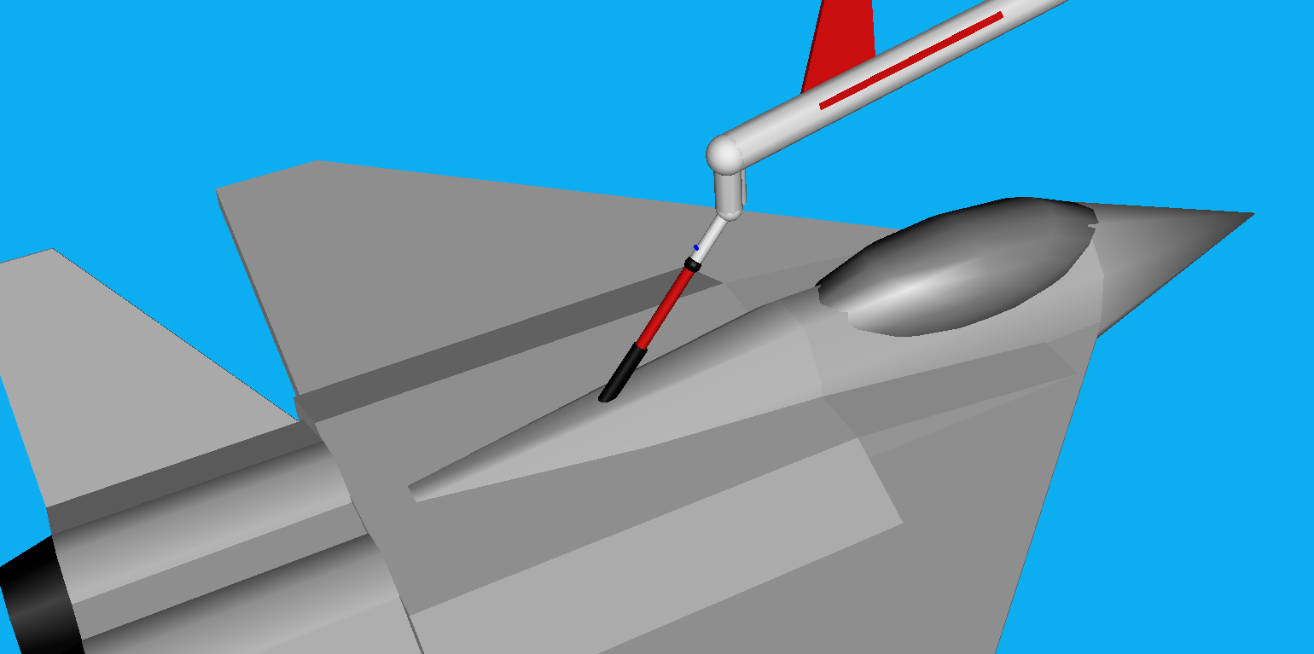
Robotic Task

Slide 5
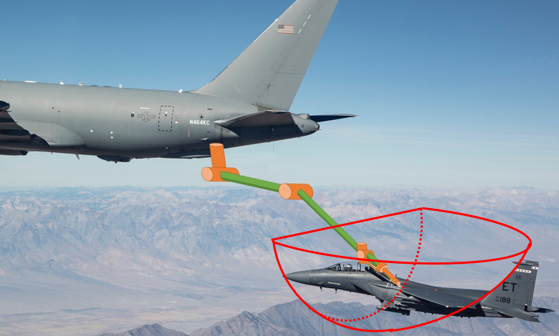
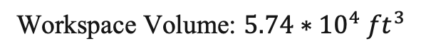
Robotic Task (Tool Tip Workspace Volume)
Workspace Volume: $5.74∗{10}^{4} {ft}^{3}$

Slide 6
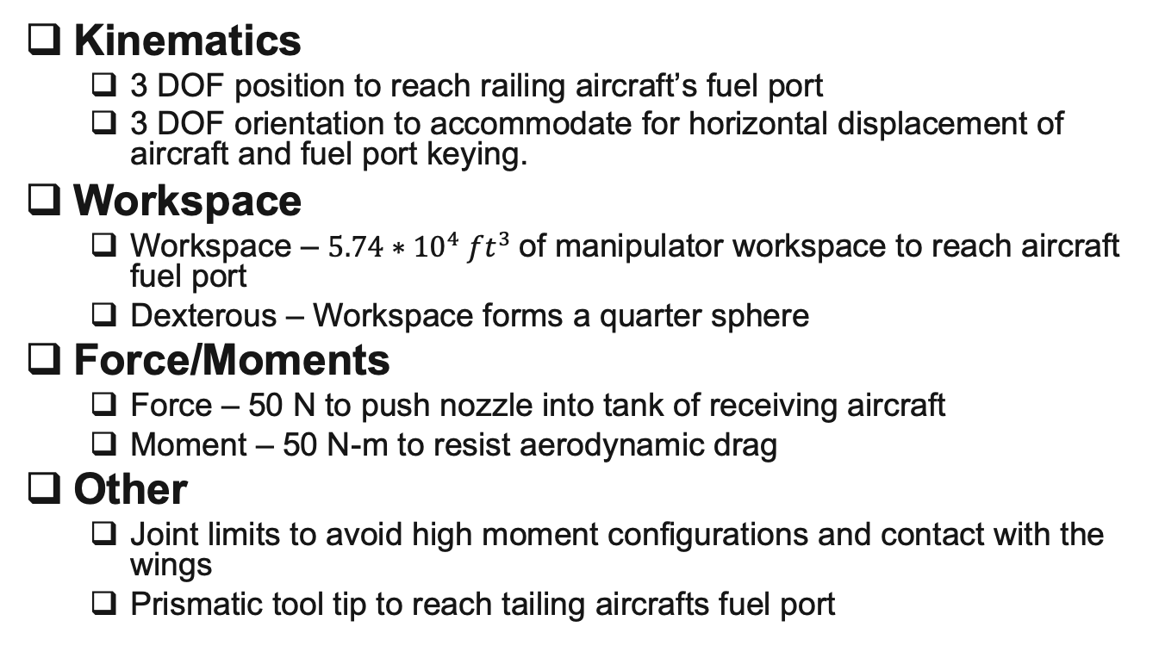
Robotic Task (Requirements)
Kinematics
3 DOF position to reach railing aircraft’s fuel port
3 DOF orientation to accommodate for horizontal displacement of aircraft and fuel port keying.
Workspace
Workspace – $5.74∗{10}^{4} {ft}^{3}$of manipulator workspace to reach aircraft fuel port
Dexterous – Workspace forms a quarter sphere
Force/Moments
Force – 50 N to push nozzle into tank of receiving aircraft
Moment – 50 N-m to resist aerodynamic drag
Other
Joint limits to avoid high moment configurations and contact with the wings
Prismatic tool tip to reach tailing aircrafts fuel port

Slide 7
Robot Design (Specifications)
Description | Specification
Total Degrees of Freedom | 6
Arm Type* | YPP
Wrist Type† | YPR (IAW-Yes)
Redundancy | None
Length Sum (L) | 39 ft
Structural Length Index (Q) | 1.01
*R=roll, P=pitch, Y=yaw, D=prismatic
†IAW-intersecting axis wrist

Slide 8
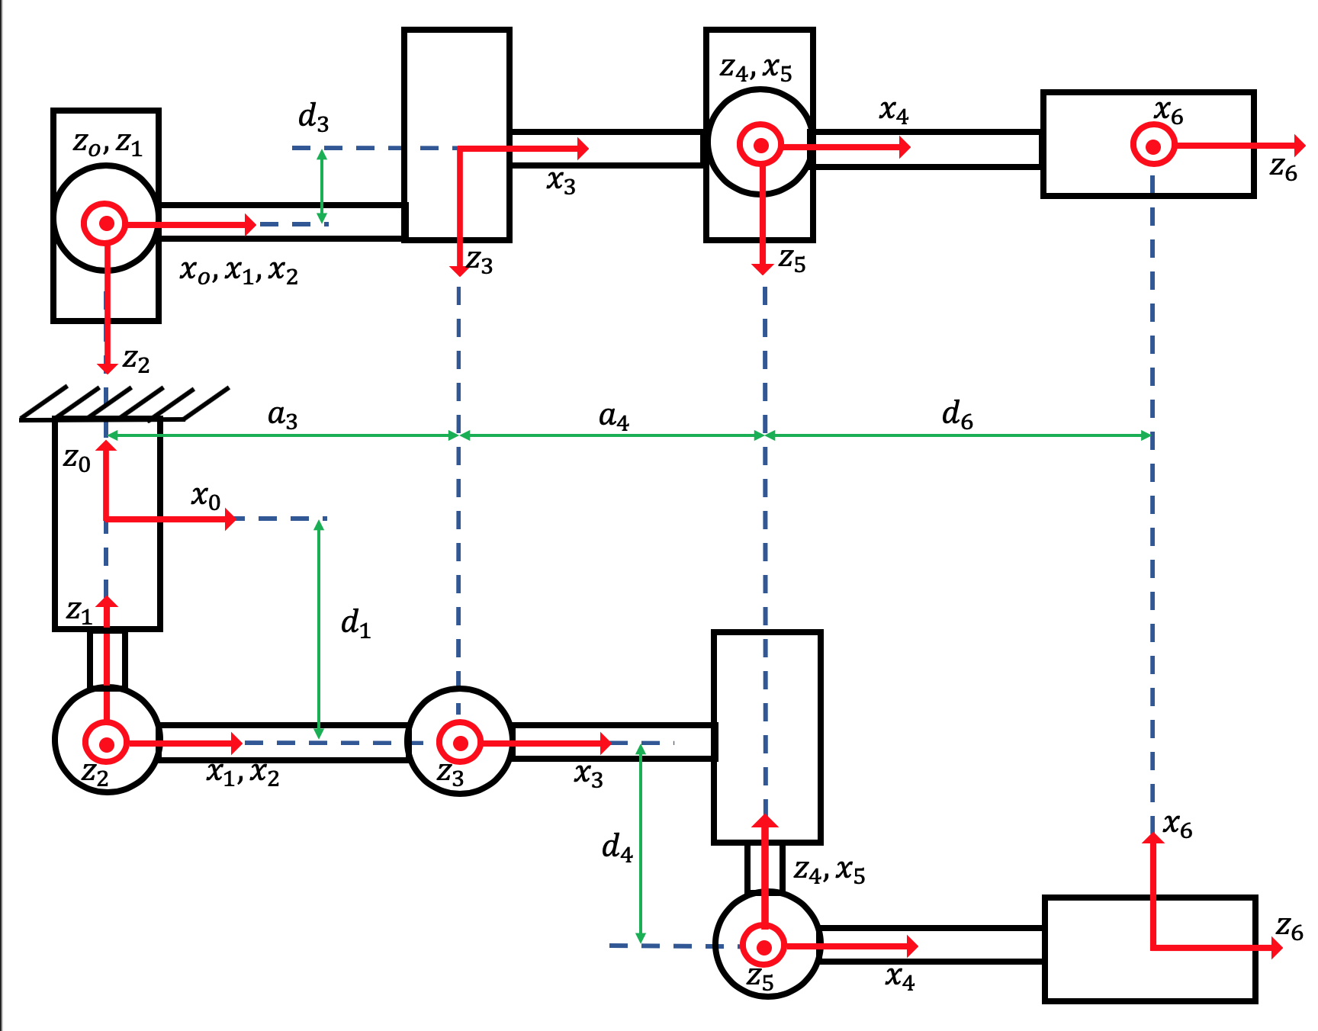
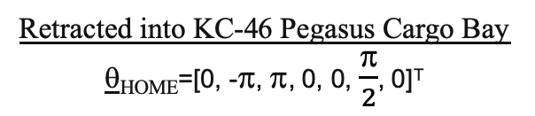
Robot Design (Link Frames)
Retracted into KC-46 Pegasus Cargo Bay θ_{ΗΟΜΕ}=[0, -π, π, 0, 0, $\frac{\text{p}}{2}$, 0]^{T}

Slide 9
Robot Design (D-H Table)
i | a_{i-1} (deg) | a_{i-1} (m) | d_{i} (m) | q_{i} (deg) | JL⁻ (deg) | JL⁺ (deg)
1 | 0 | 0 | -1 | q₁ | -30 | 30
2 | 90 | 0 | 0 | q₂ | -30 | 0
3 | 0 | 20 | -1 | q₃ | -30 | 0
4 | -90 | 15 | -1 | q₄ | -45 | 45
5 | 90 | 0 | 0 | q₅ | 20 | 90
6 | 90 | 0 | 1 | q₆ | 0 | 360

Slide 10
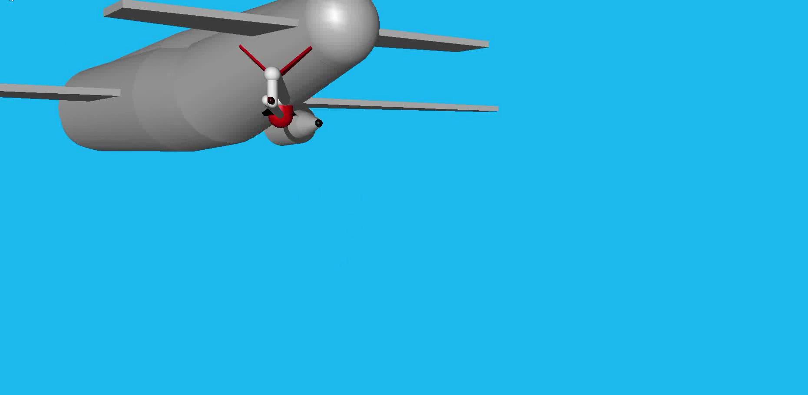
Robot Design (Joint Animation)

Slide 11

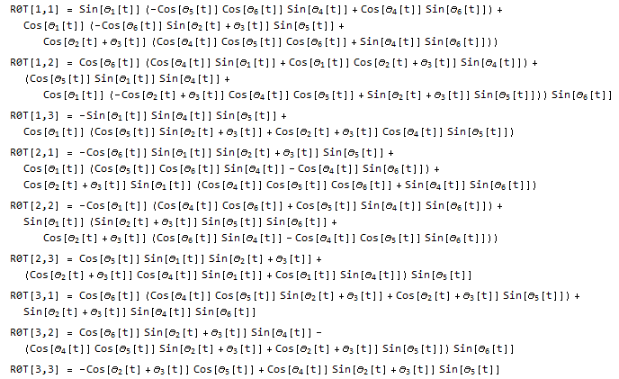
Forward Kinematics
Forward Kinematics of the Tool Tip:
Orientation of the Tool Tip (Mathematica):

Slide 12
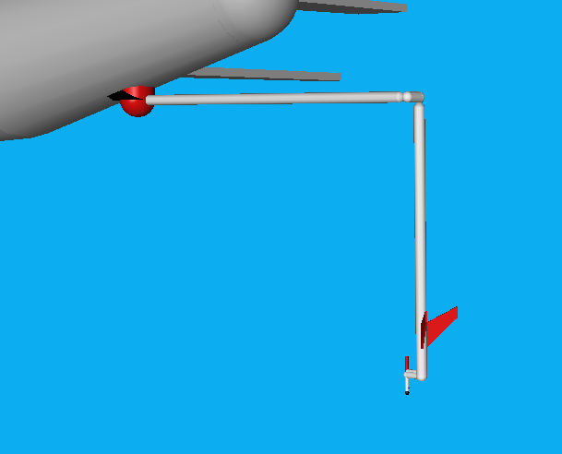
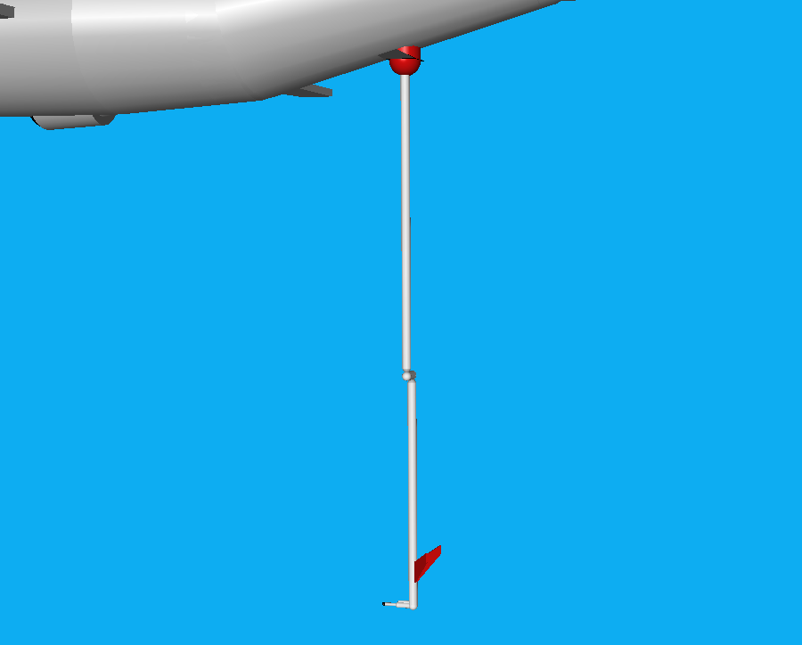
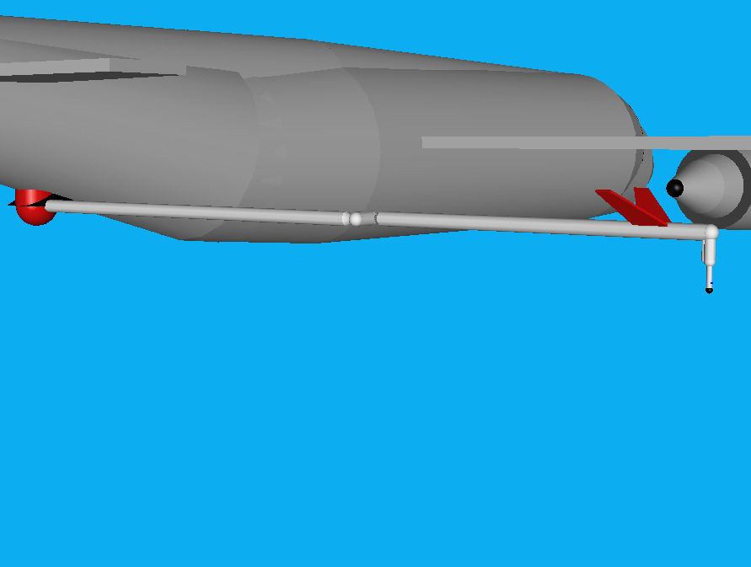
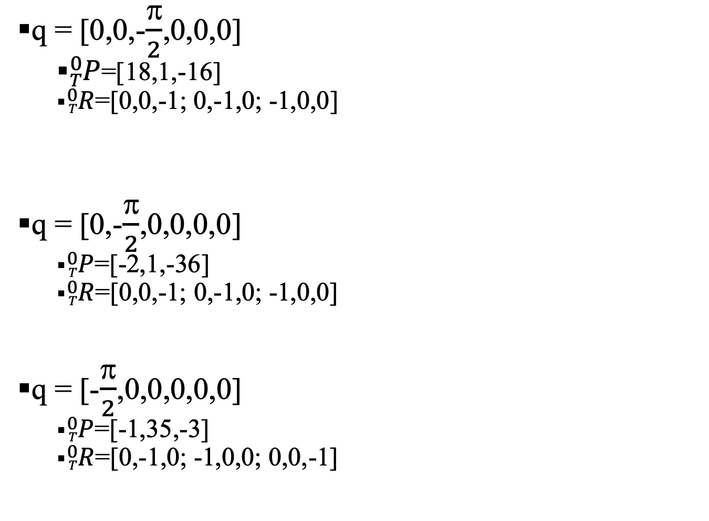
Forward Kinematics (Test)
q = [0,0,-$\frac{\text{p}}{2}$,0,0,0]
${}_{T}^{0}P$=[18,1,-16]
${}_{T}^{0}R$=[0,0,-1; 0,-1,0; -1,0,0]
q = [0,-$\frac{\text{p}}{2}$,0,0,0,0]
${}_{T}^{0}P$=[-2,1,-36]
${}_{T}^{0}R$=[0,0,-1; 0,-1,0; -1,0,0]
q = [-$\frac{\text{p}}{2}$,0,0,0,0,0]
${}_{T}^{0}P$=[-1,35,-3]
${}_{T}^{0}R$=[0,-1,0; -1,0,0; 0,0,-1]

Slide 13
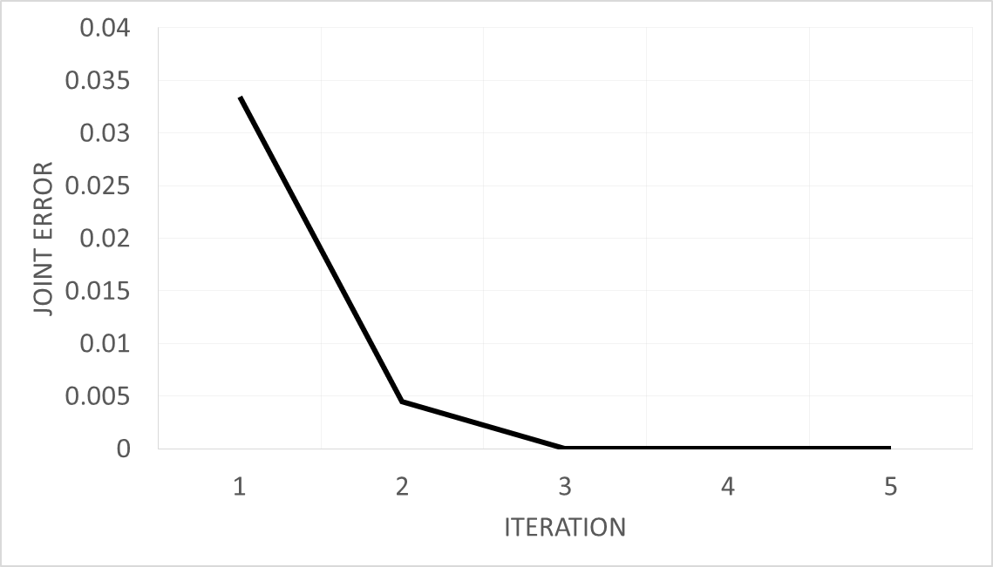
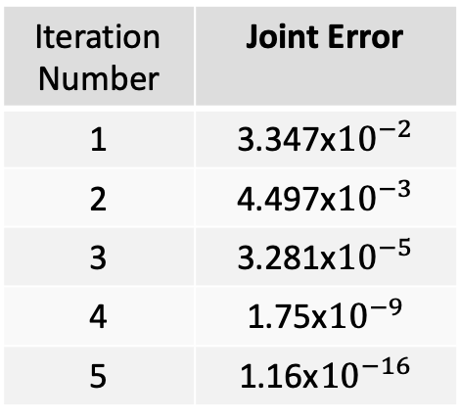
Inverse Kinematics (Solution - Iterative)
Joint Error vs. Iteration Number
Iteration Number | Joint Error
1 | 3.347x${10}^{−2}$
2 | 4.497x${10}^{−3}$
3 | 3.281x${10}^{−5}$
4 | 1.75x${10}^{−9}$
5 | 1.16x${10}^{−16}$

Slide 14
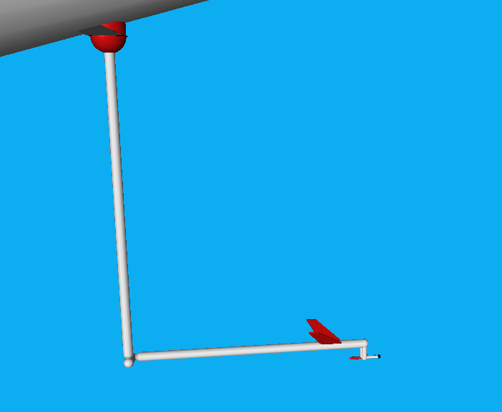
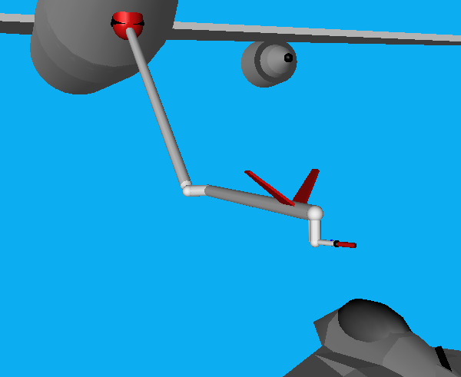
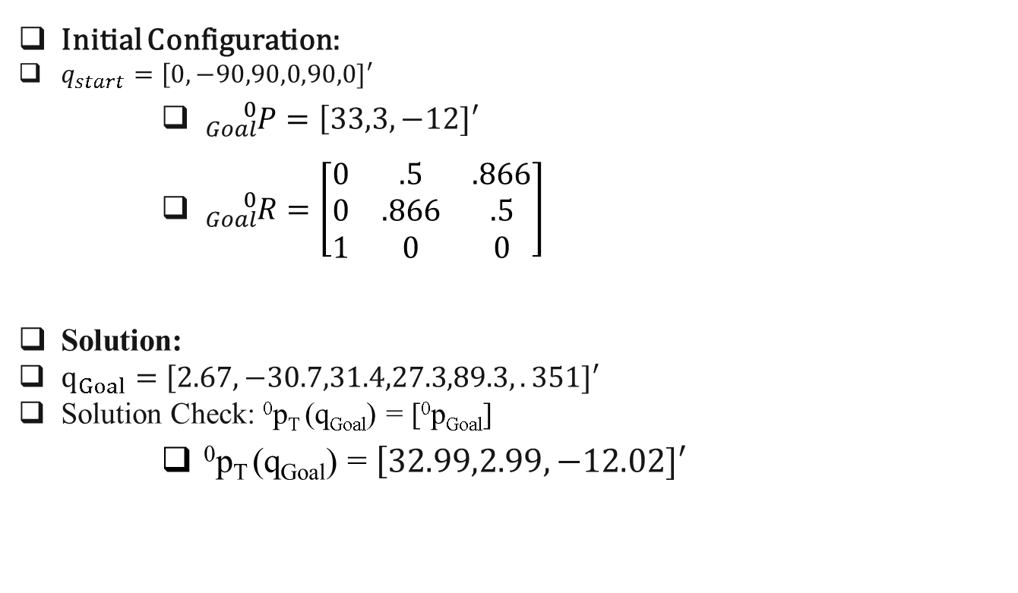
Inverse Kinematics (Test)
Initial Configuration:
$q_{start}=\left[0,−90,90,0,90,0]′\right.$
${}_{Goal}^{0}{P=\left[33,3,−12]\right.′}$
${}_{Goal}^{0}{R=\left[\begin{matrix}0 & .5 & .866 \\ 0 & .866 & .5 \\ 1 & 0 & 0\end{matrix}\right]}$
Solution:
$q_{Goal}=\left[2.67,−30.7,31.4,27.3,89.3,.351]′\right.$
Solution Check: ⁰p_{T} (q_{Goal}) = [⁰p_{Goal}]
⁰p_{T} (q_{Goal}) = $\left[32.99,2.99,−12.02]\right.′$

Slide 15




Jacobian (Simplest Frame)
Translational Jacobian Simplest Frame: Frame 4
$$J_{t}(Column 1)$$
$$J_{t}(Column 2)$$
$$J_{t}(Column 3)$$
$$J_{t}(Column 4−6)$$
Rotational Jacobian Simplest Frame: Frame 4

Slide 16
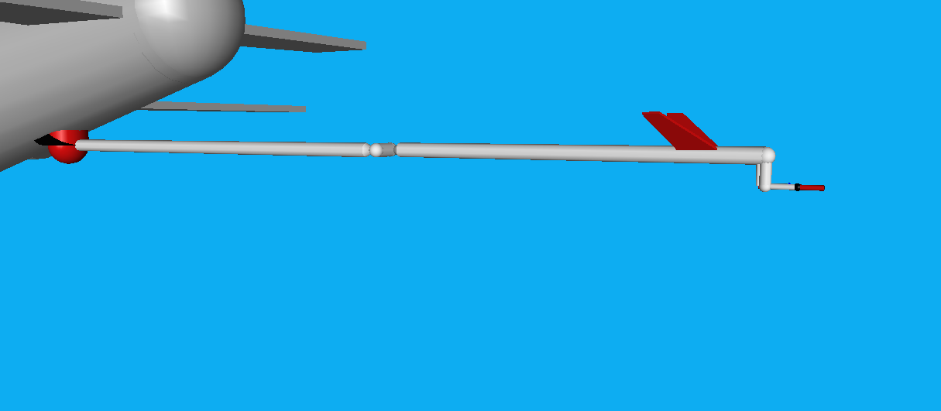
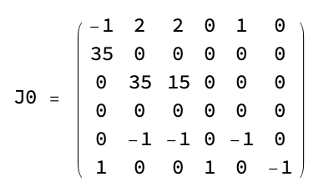
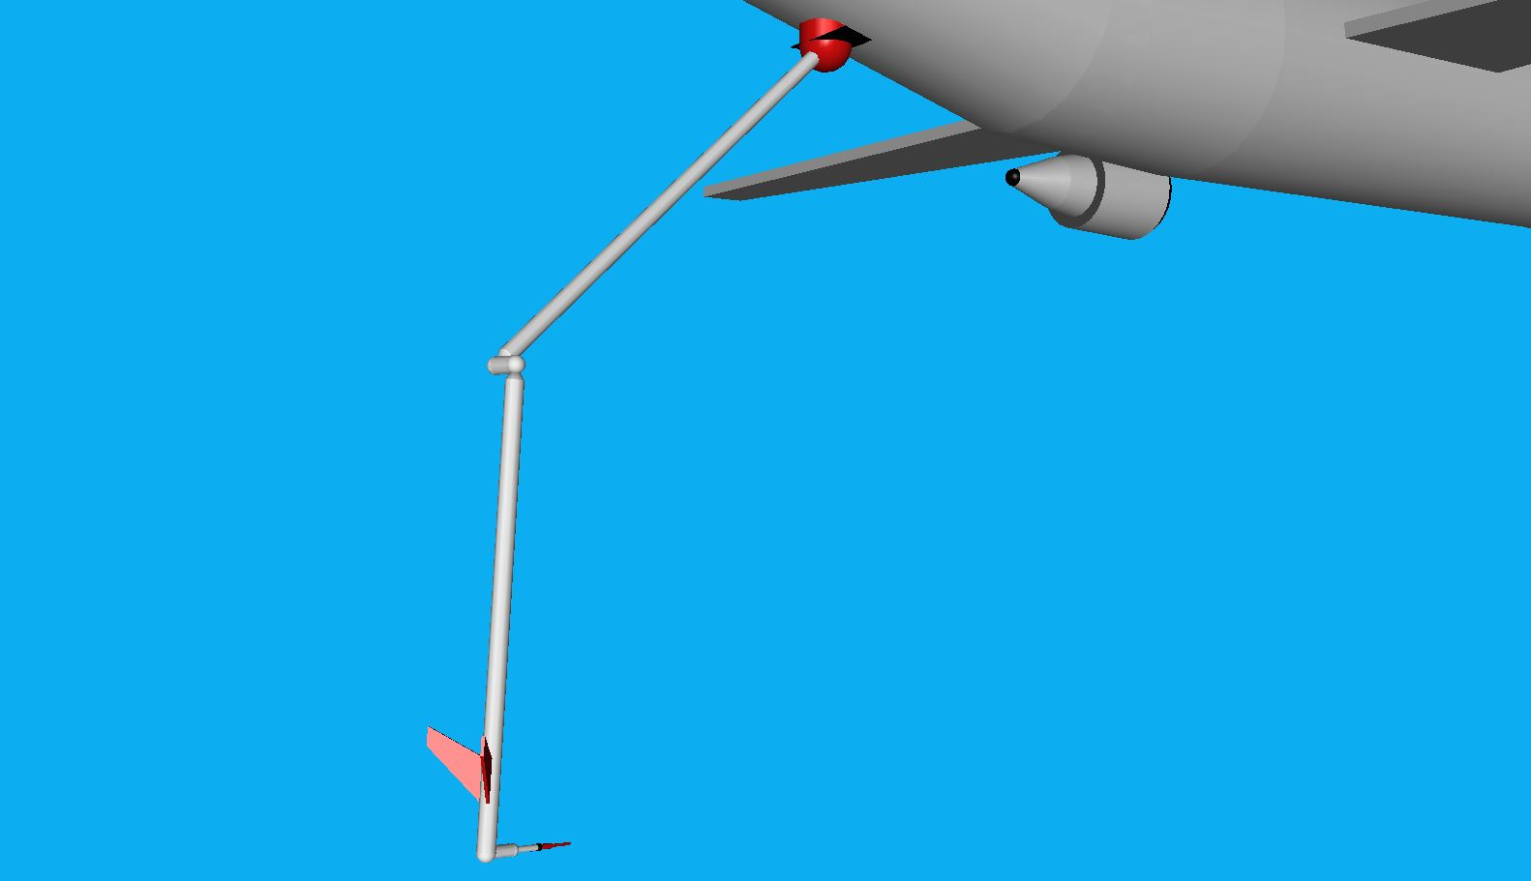

Singularities
Boundary:
Internal:
linearly dependent columns
$$θ_{5}=0$$
linearly dependent columns

Slide 17
Maximum Load

Slide 18
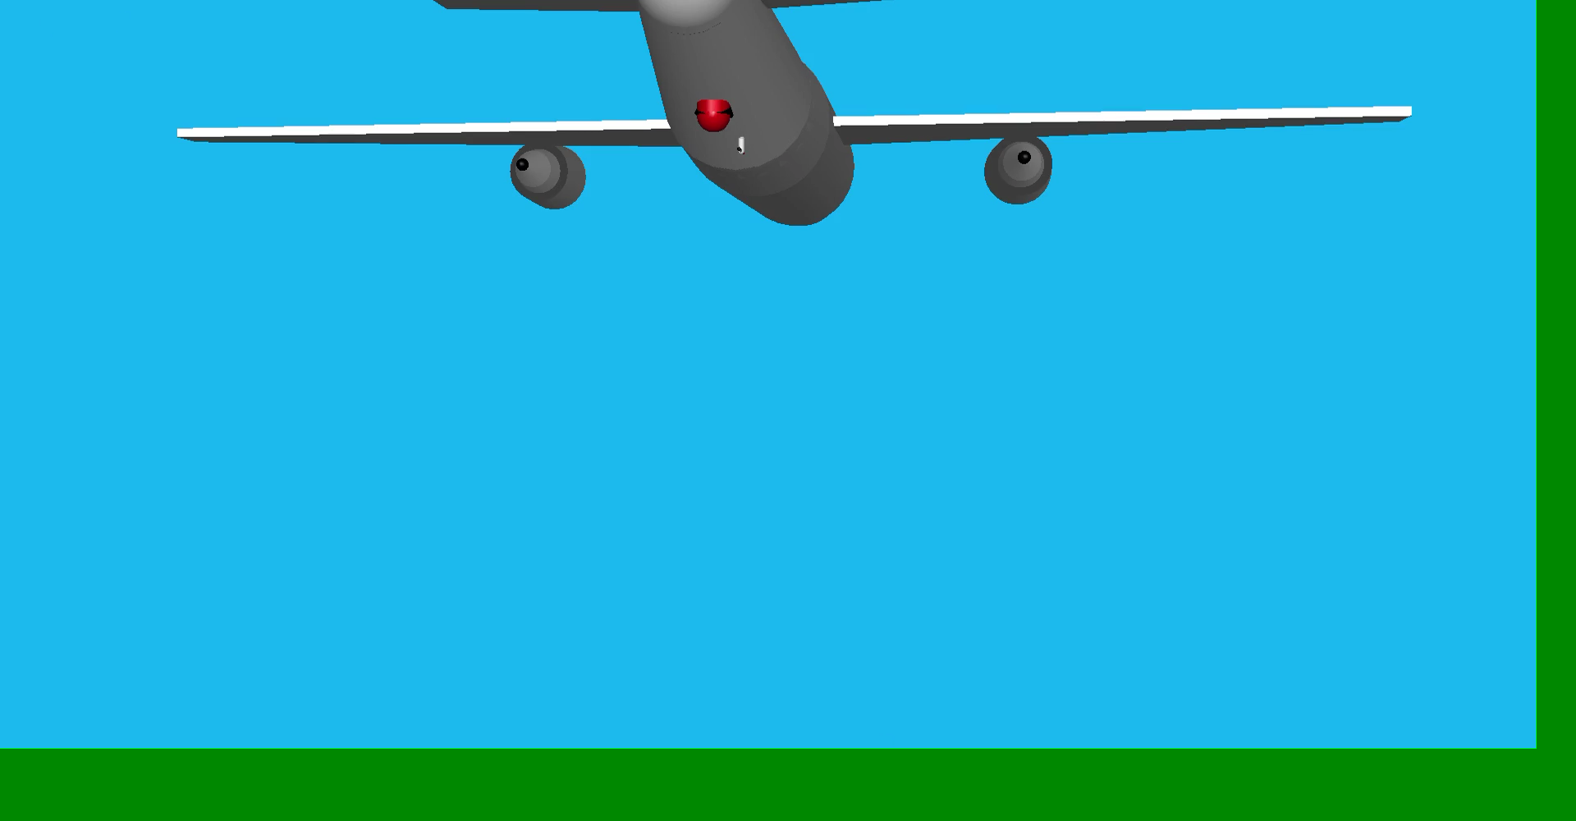
Task (Animation)

Slide 19
Conclusions
Robot Design
Joint design could be improved
Future Work
Kinematic redundancy should be added for obstacle avoidance
Could be used on aircraft carriers for helicopter or AUVs
What I Learned
Offsets can be implemented to avoid singularities
RoboWorks is literally AMAZING

